Slide 1


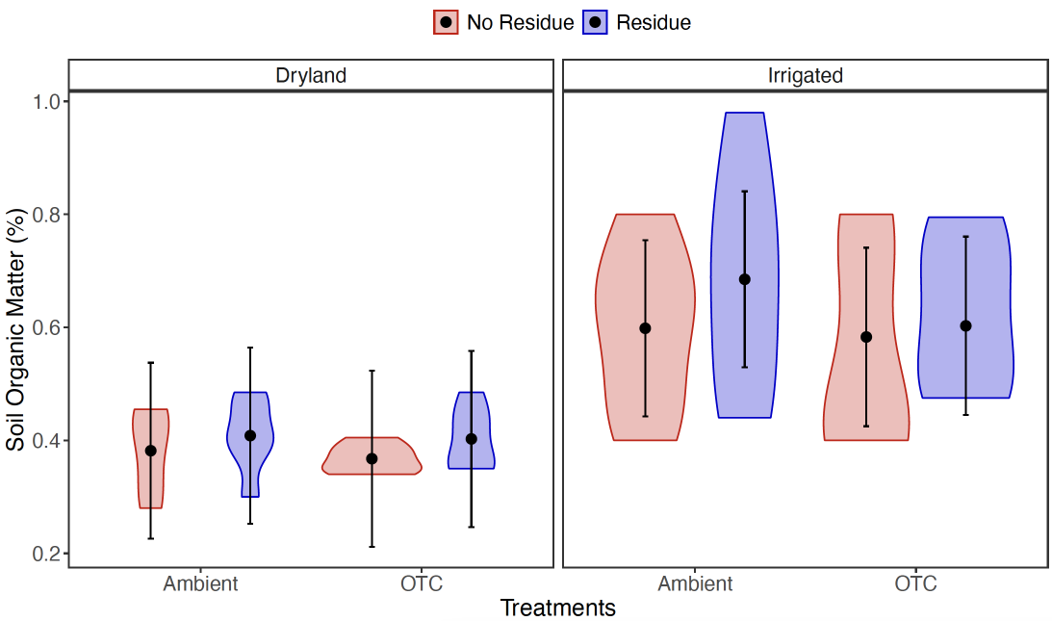
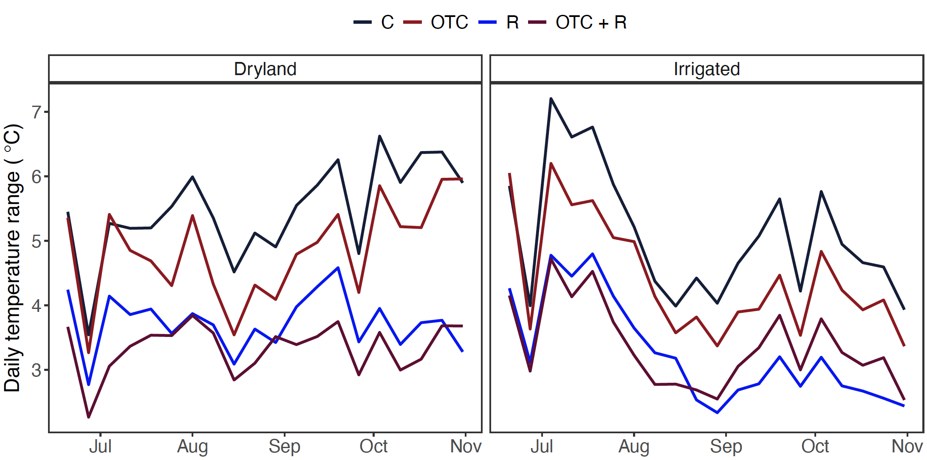
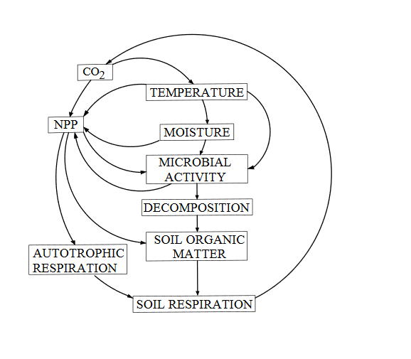
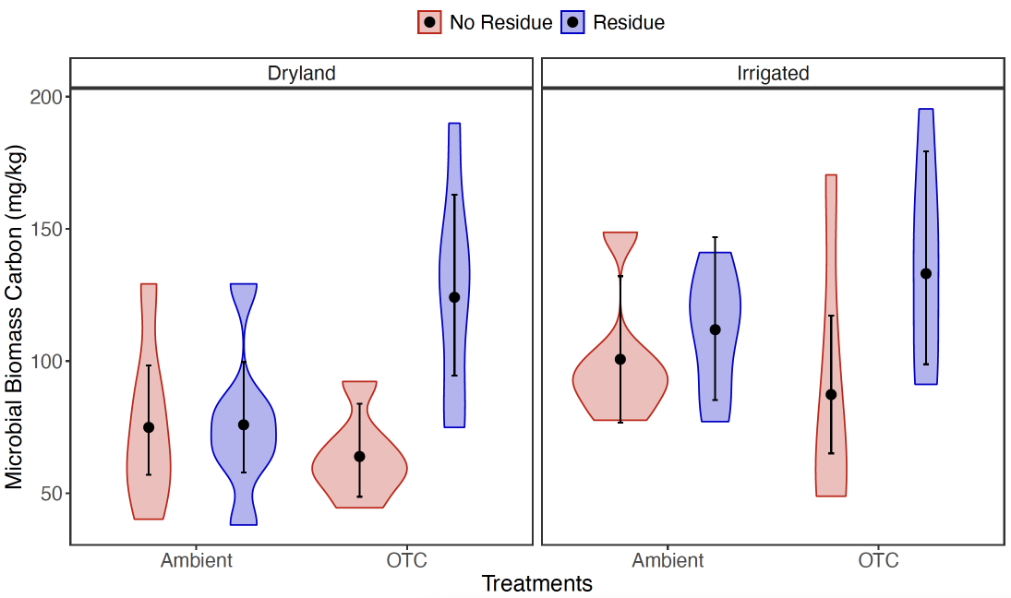
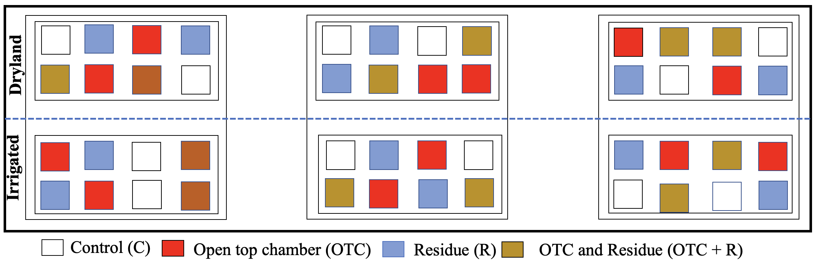
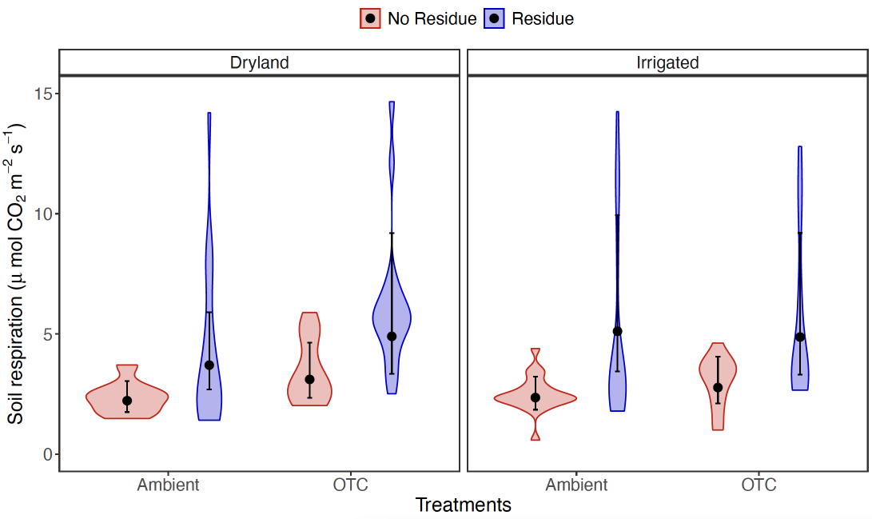
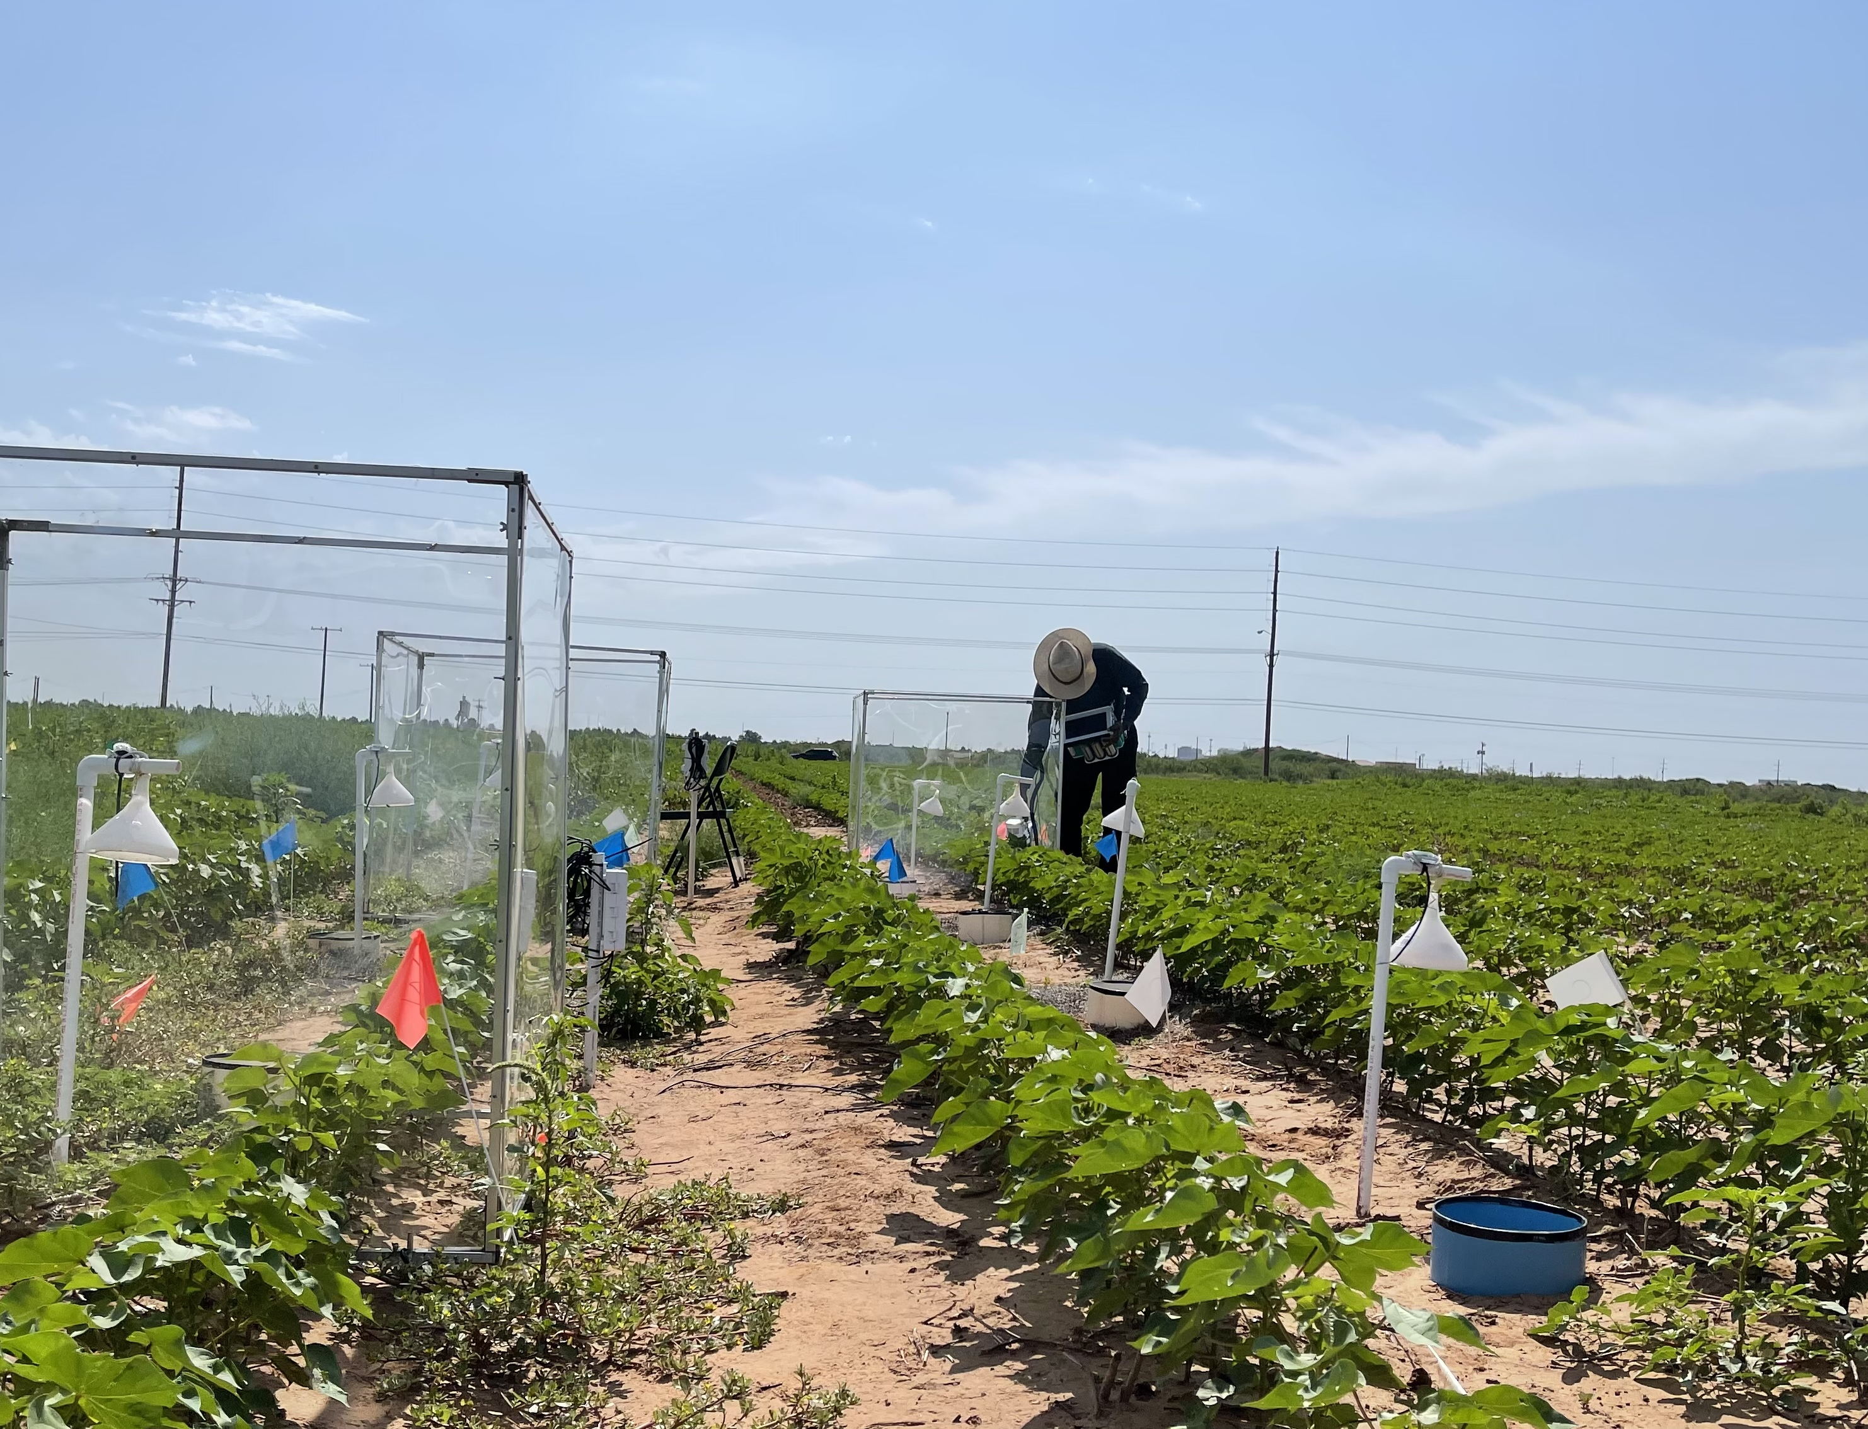
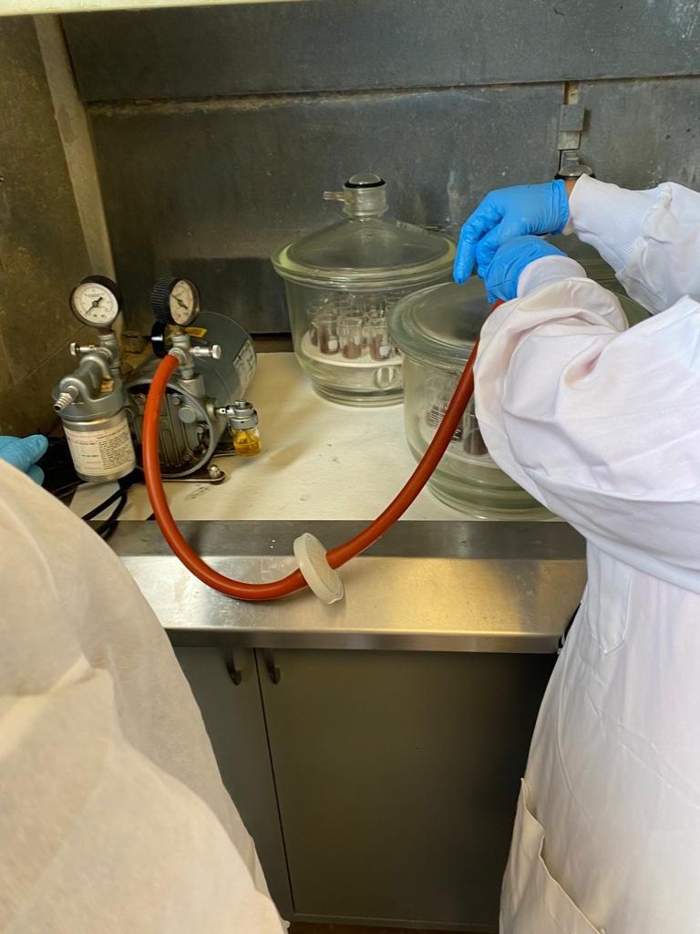



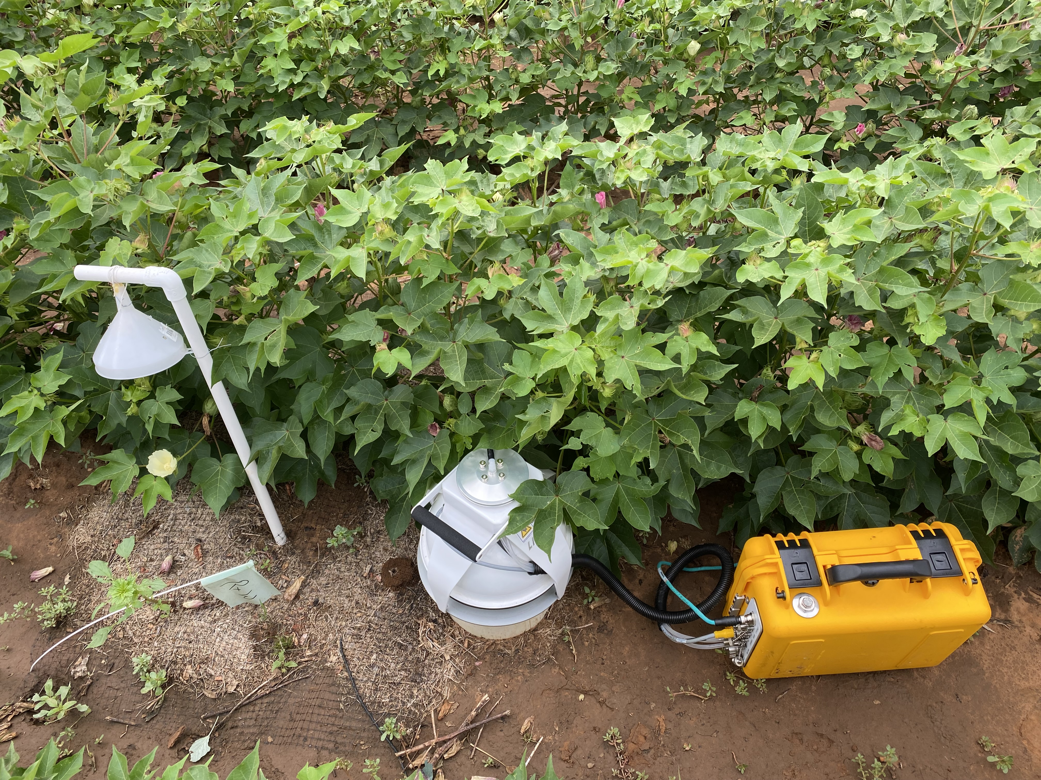


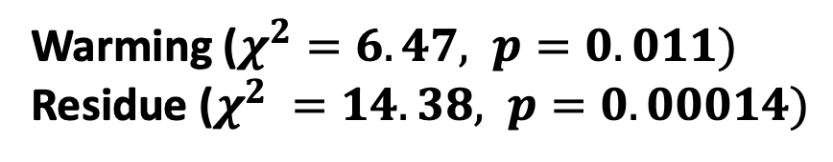

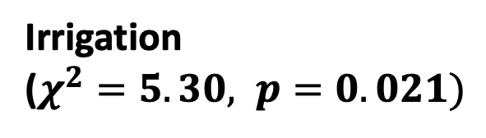
Effects of Soil Warming on Soil Carbon Dynamics with Residue and
Irrigation Management in Upland Cotton.
Pawan Devkota^{1*}, Nicholas G. Smith¹, Lindsey C. Slaughter², and Natasja van Gestel¹
¹Department of Biological Sciences, Texas Tech University, Lubbock, TX, 79409
²Department of Plant and Soil Sciences, Texas Tech University, Lubbock, TX, 79409
INTRODUCTION
RESULTS
RESULTS
Cotton productivity in Texas High Plains is declining due to higher mean temperatures, droughts, and extreme rainfall events during growing season (Steiner et al., 2018).
Fig 1: Climate carbon feedback .
The water table in Ogallala aquifer is declining which could reduce yields by up to half (Dorminey, 2012).
Residue reduces soil temperature and moisture fluctuation in soil profile (Russel 1940). Therefore, residue retention could be an effective strategy for reducing the degradation of soil health during climate extremes.
OBJECTIVES:
Study the effects of warming on soil carbon dynamics and cotton production.
Determine how irrigation and residue management affects warming effects on soil carbon stocks and cotton production.
Organic matter content in irrigated fields showed 37% higher than in dryland.
Residue minimized the diurnal variation in soil temperature
Irrigation
($χ^{2}=5.30, p=0.021)$
Irrigation increased aboveground biomass, belowground biomass and seed cotton yield.
CONCLUSIONS
OTCs increased MBC by 34.9% under residue application, but without residue, OTCs decreased MBC by 14.1 %.
Residue addition and irrigation helped to mitigate the warming effects by stabilizing soil temperature, increasing organic matter and microbial carbon, thus might aid to attenuate the impact of future climate change on soil health and crop production in semiarid environments.
Cotton production was improved by irrigation, but the great plains region is experiencing an alarming rate of water depletion. Therefore, future study should focus on methods for conserving soil moisture in order to assure the sustainability of soil health and agricultural productivity in this area.
Warming : Residue
($χ^{2}=4.75, p=0.029)$
REFERENCES
MATERIAL AND METHODS
Dorminey, B. (2012, November). Dryland Farmers Work Wonders without Water in U.S. West . Scientific American.
Russel, J. C. (1940). The Effect of Surface Cover on Soil Moisture Losses by Evaporation. Soil Science Society of America Journal, 4(C), 65–70.
Steiner, J. L., Briske, D. D., Brown, D. P., & Rottler, C. M. (2018). Vulnerability of Southern Plains agriculture to climate change. Climatic Change, 146(1–2), 201–218.
OTCs and residue increased soil CO₂ flux by 20.7% and 103.1 %, respectively.
ACKNOWLEDGEMENT
Warming ($χ^{2}=6.47, p=0.011)$
Residue ($χ^{2} =14.38, p=0.00014)$
We would like to thank Cotton Inc., James A. “Buddy” Davidson Charitable Foundation, and Texas Tech University Department of Biological Sciences for funding support. We thank Dr. Dylan Schwilk for his insights and help during OTC construction, Mr Lelton Howell for facilitating field activities. Thanks to all EcoHealth lab members for their valuable supports, guidance and insights during the project period.
Fig 2: Split plot randomized complete block design
Scan to download
the full presentation
Fig 3: A) Field setup b) Soil respiration measurement c) Chloroform fumigation for microbial biomass measurement

